Slide 1
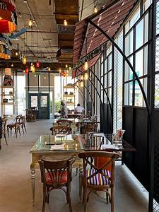
Restaurant system

Slide 2
Project idea
In this project, we organized all the data related to our restaurant in terms of employees, menus of food and drinks that we offer in the restaurant and customer data, as we created a database that includes all of this to facilitate and organize the work.

Slide 3
Project contain:-
TABLES: we have 14 table[employee ,employee salary ,employee absence ,employee bounce ,meal list ,drink list ,meal material ,drink material ,table ,booking ,drink & material ,meal & material ,employee report].
Query: we have 11 query.
report: we have 16 report.
Forms: we have 7 form
Navigation form: 2 form
One start form.

Slide 4
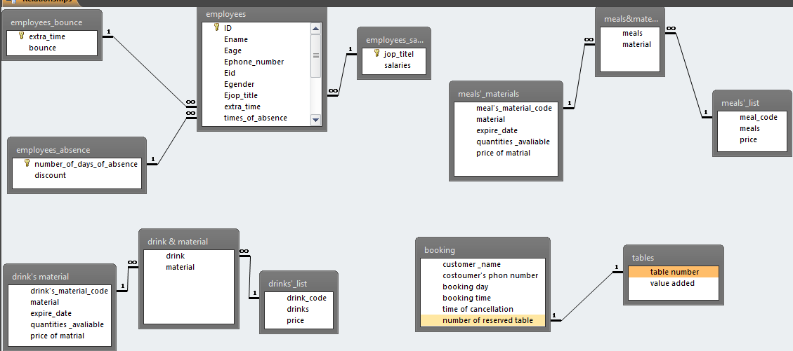
ERD

Slide 5
Employee table
We make table take [name of employee and his age ,telephone number ,social security number ,gender ,job title ,extra hours ,number of absent days , the shift ,email of employee and his photo.
this table has primary key “id”.
This table is related to the employee salary table with a many-to-one relationship as this table have the job title and the salary.
This table is related to the employee absence table with a many-to-one relationship as this table contain of number of absent days and discount.
This table is related to the employee bounce table with a many-to-one relationship as this table contain of number of extra hours and bounce.

Slide 6
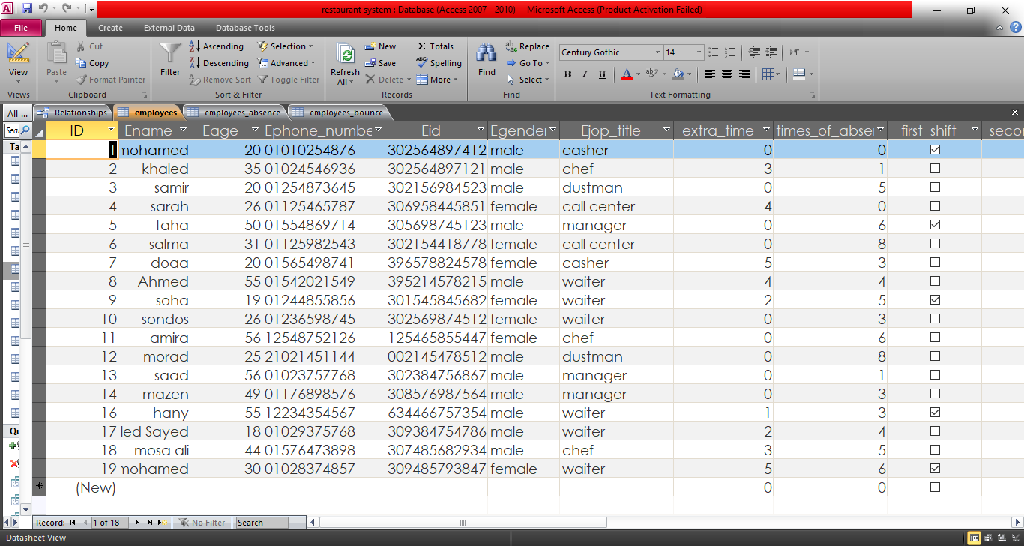
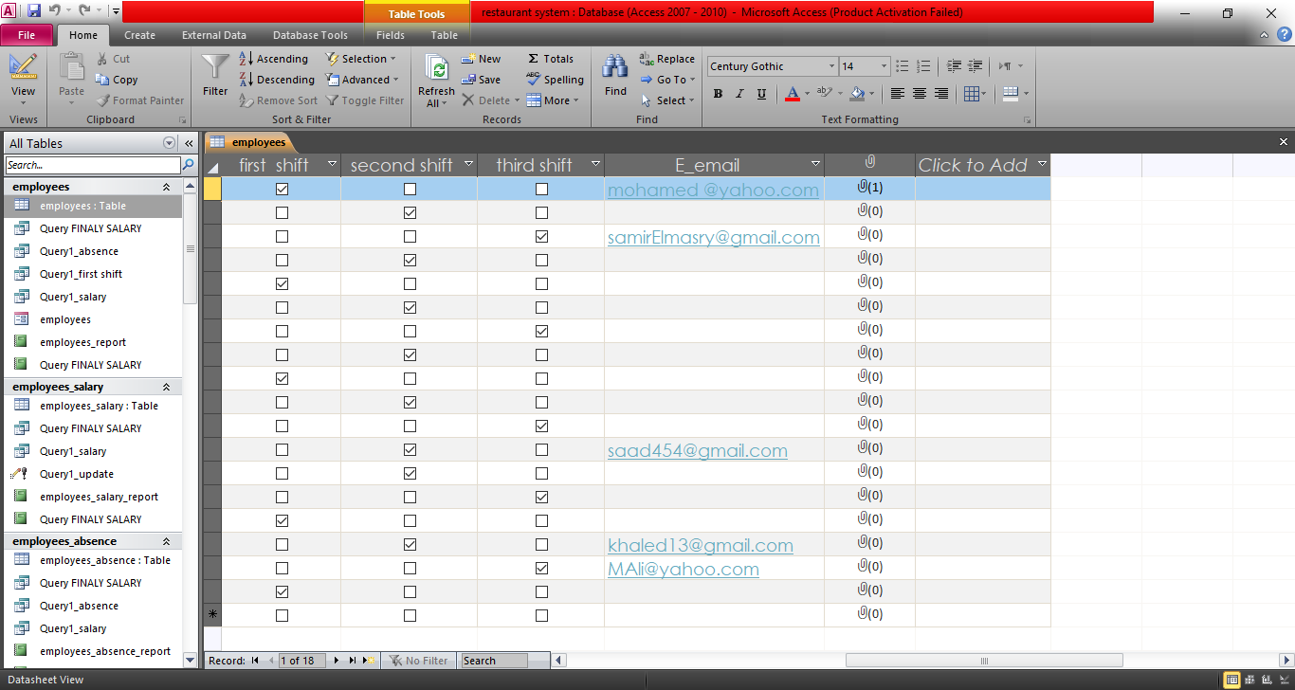
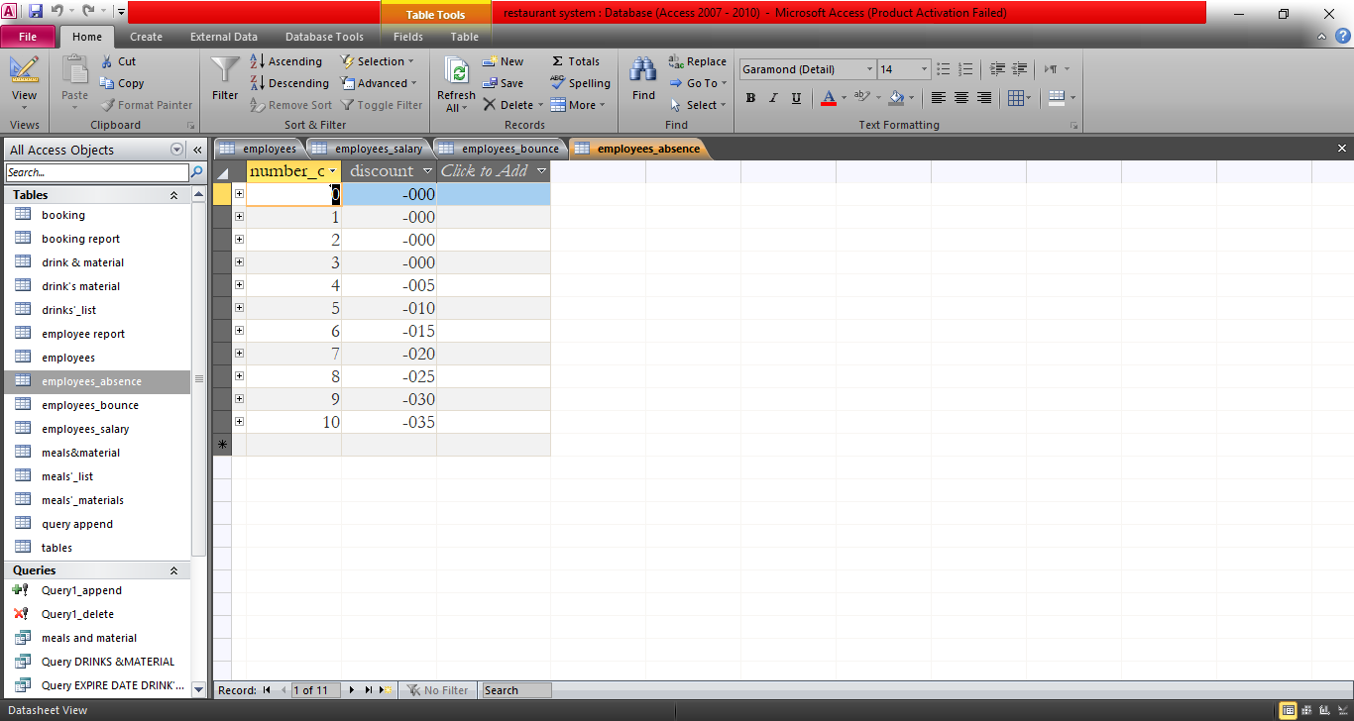
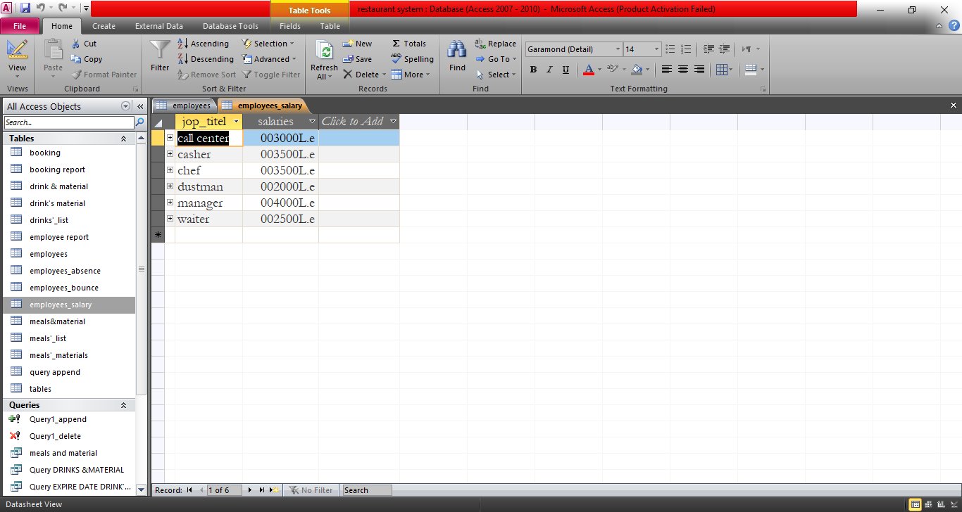
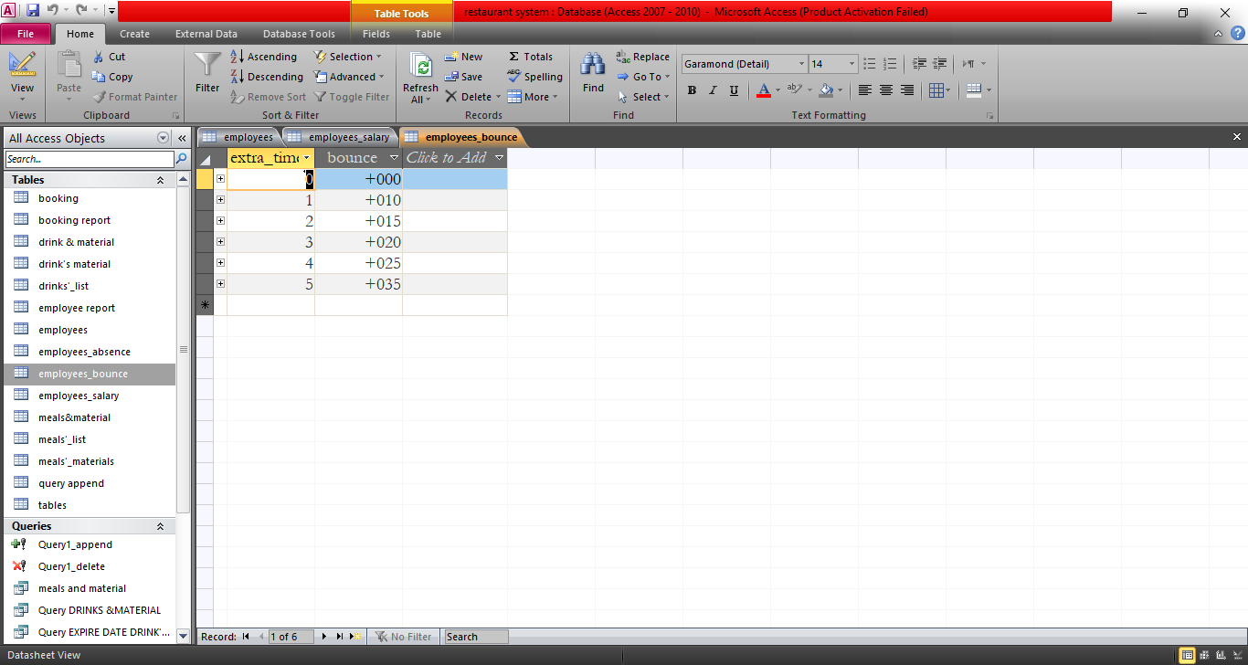
Query employees
Employee table
Employee salary Employee bounce: Employee discount

Slide 7
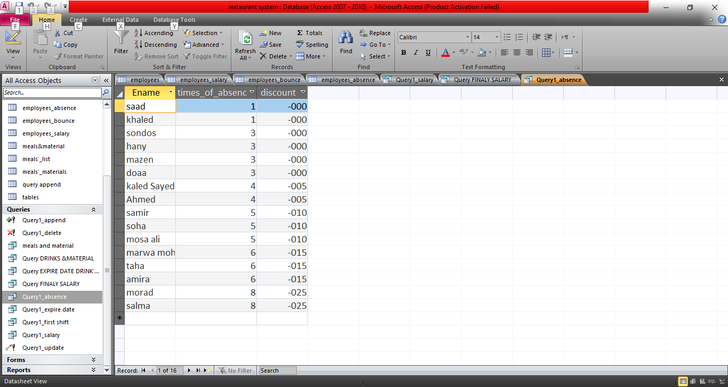
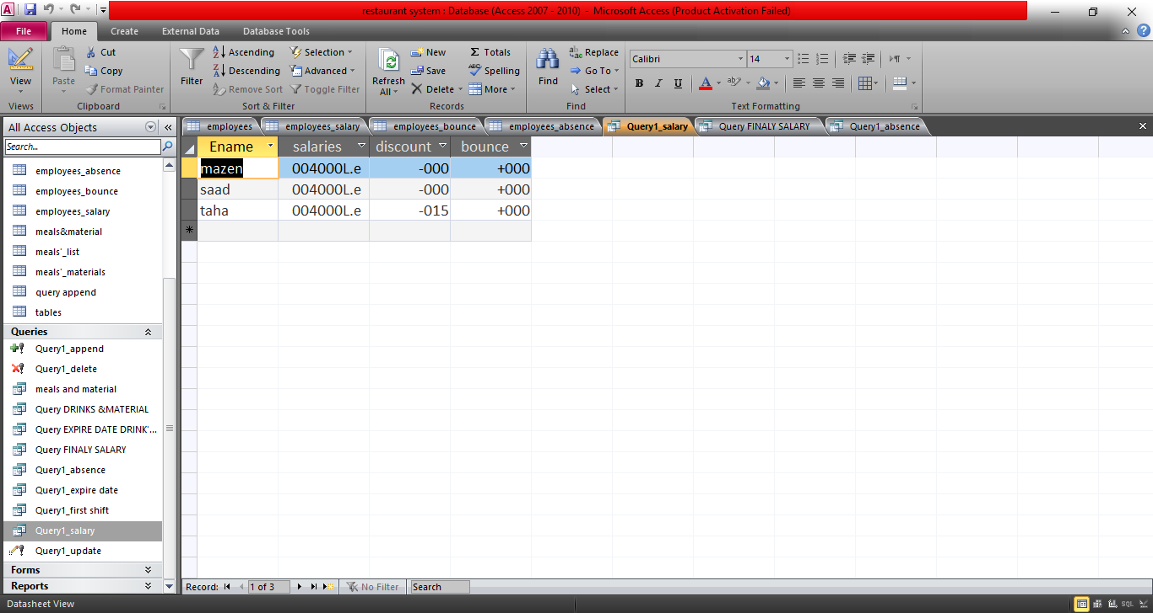
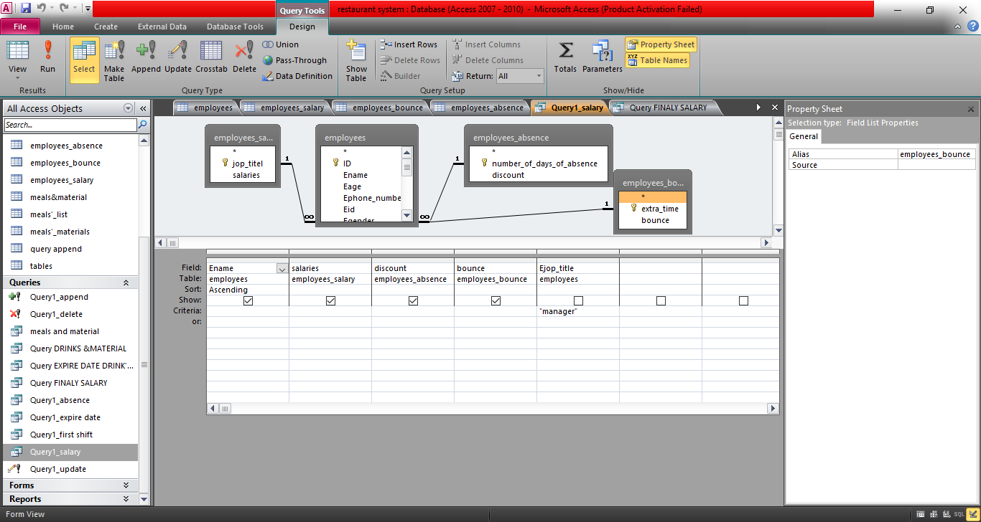
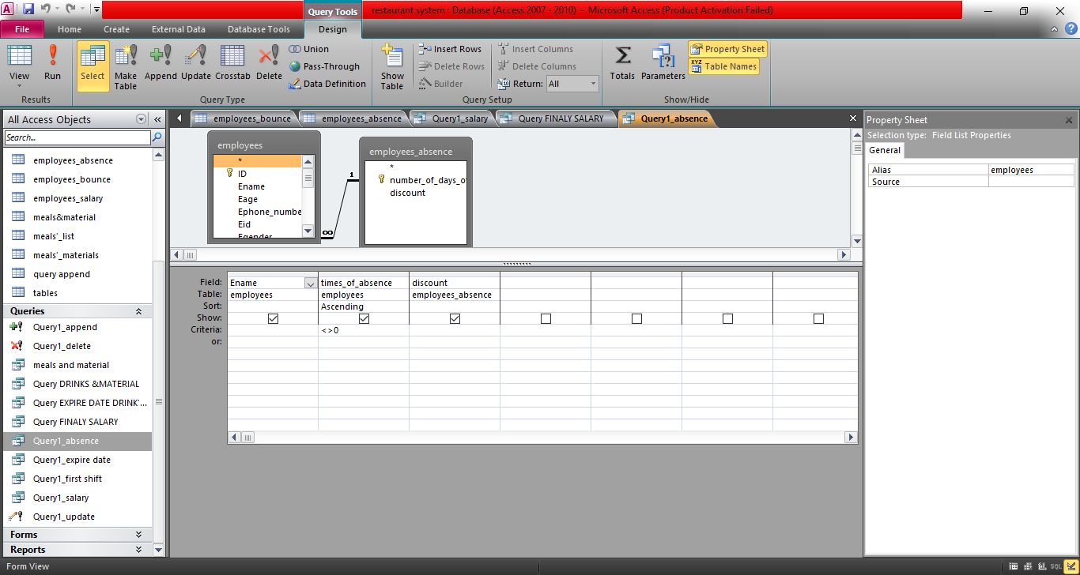
Query employees
Absent employees salary of manager

Slide 8
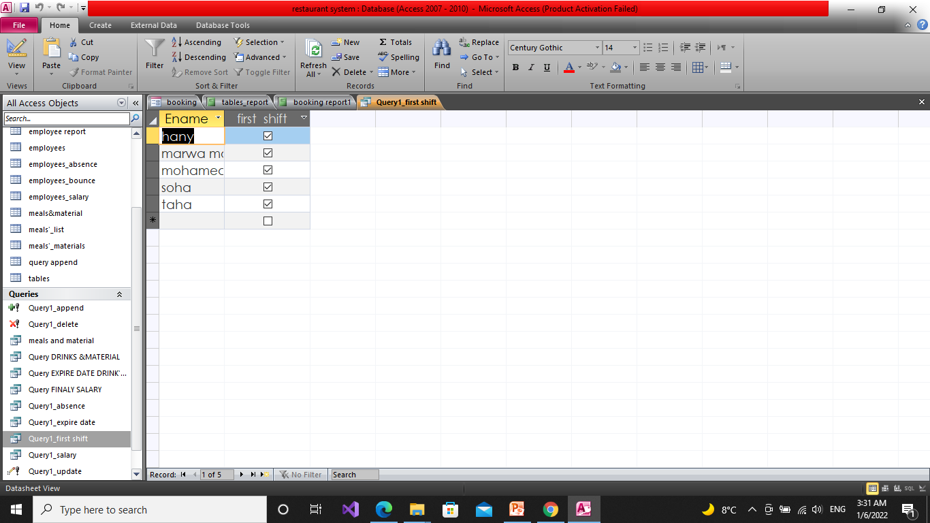
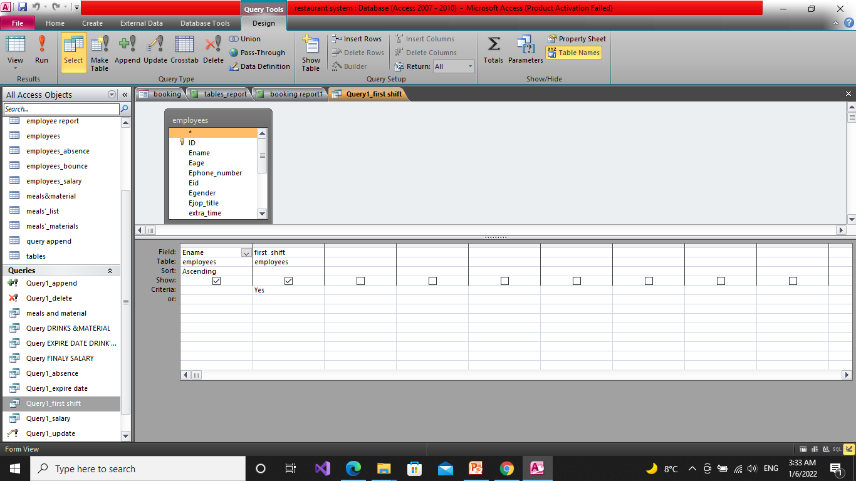
Query employees
Frist shift:

Slide 9
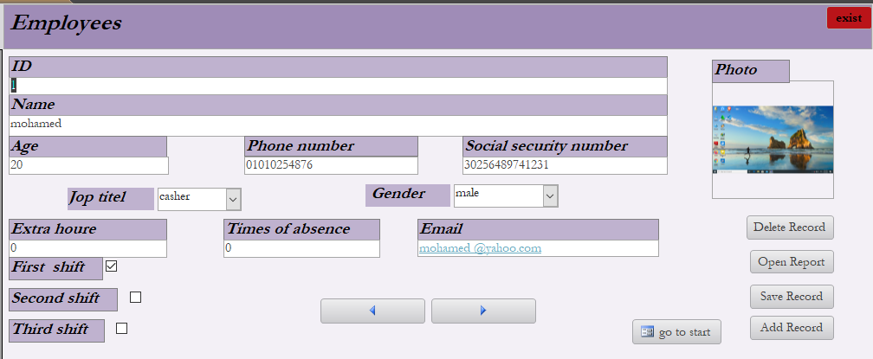
Employees form and report
Employee form

Slide 10
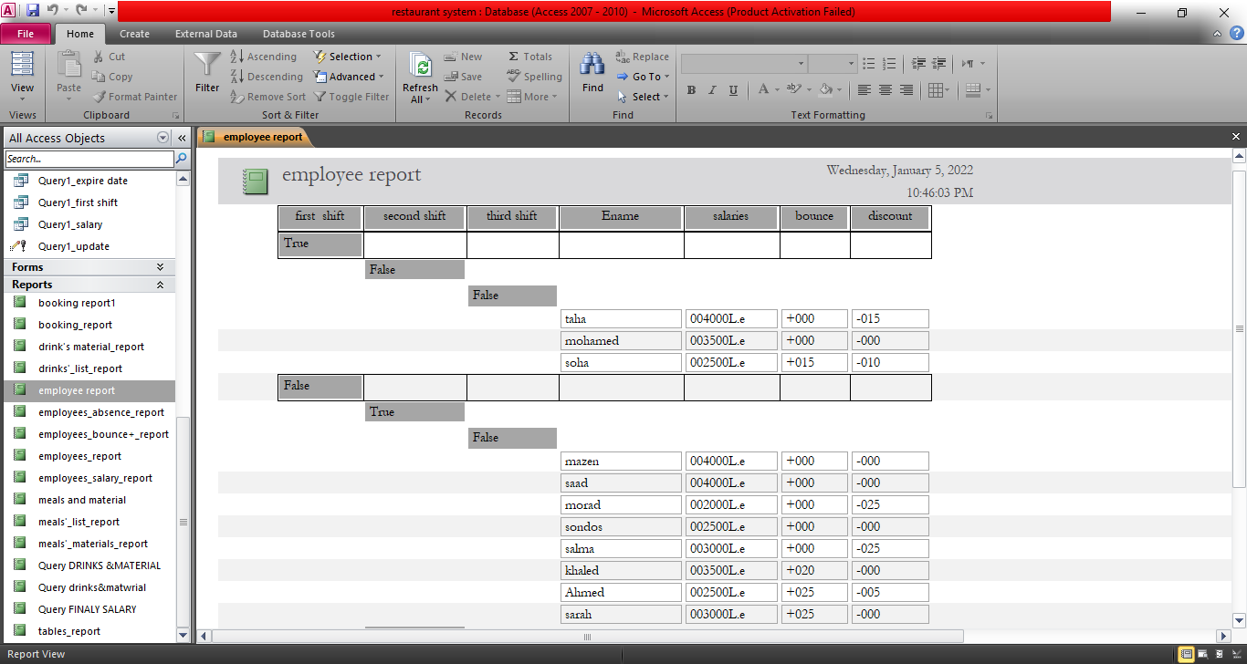
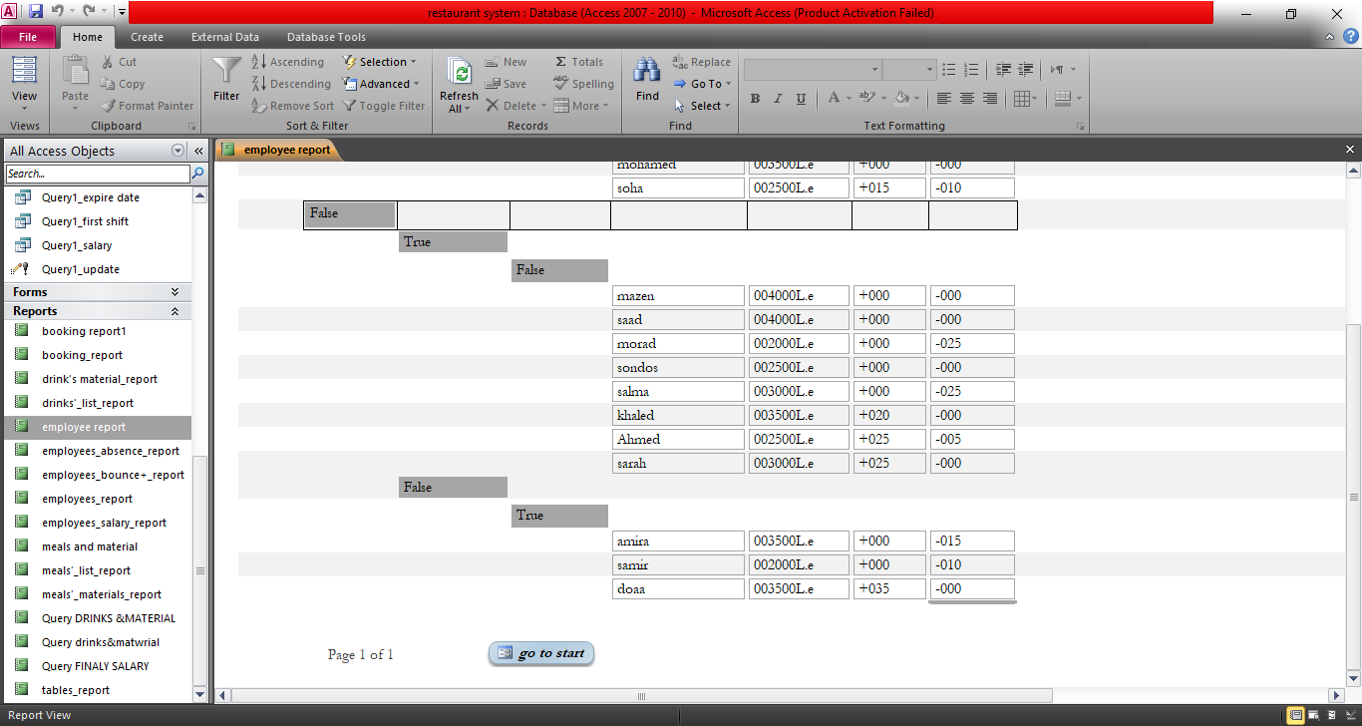
Employees form and report
employee salary report:

Slide 11
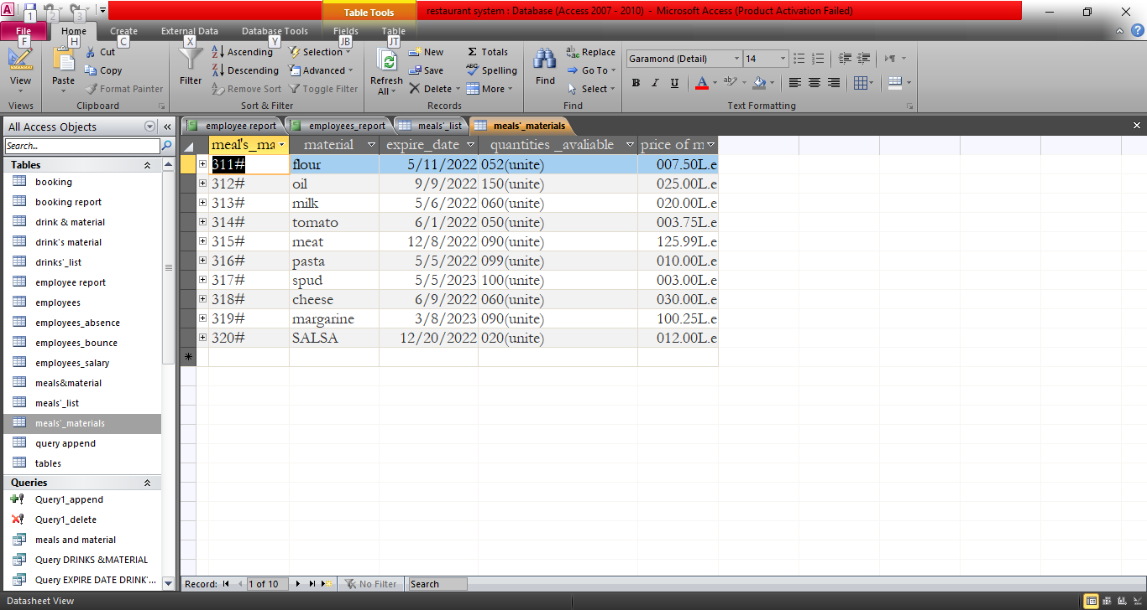
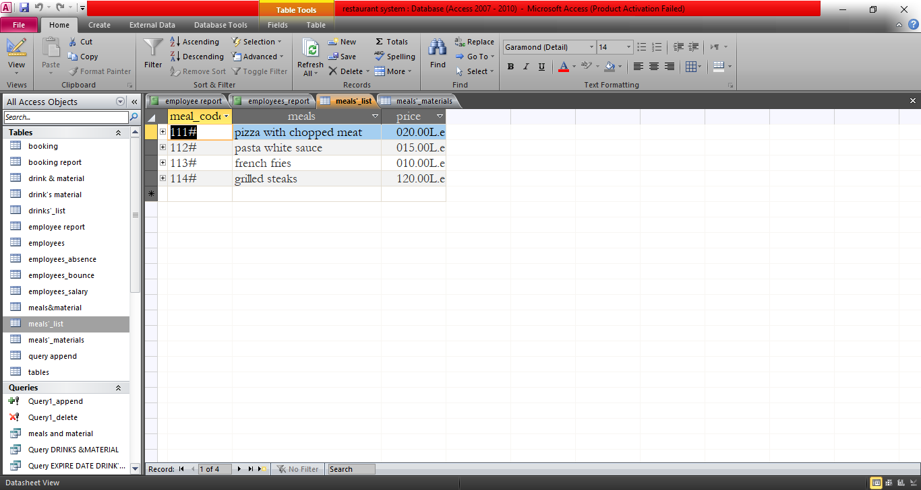
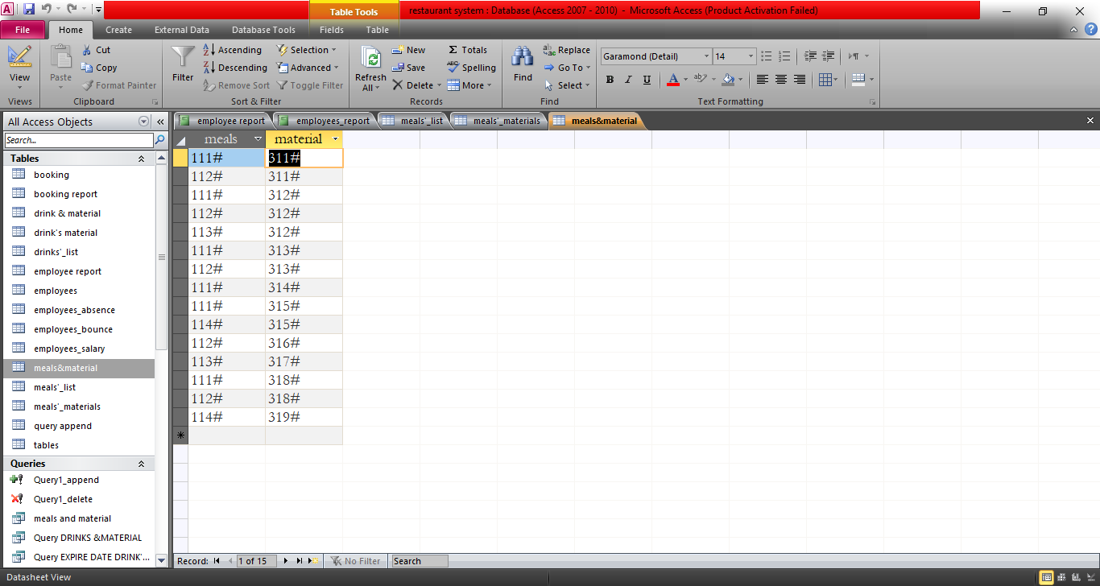
Meal and material tables
Meal table contain of 3 columns [the code of meal ,meal ,and the price of meal] and the code meal is a primary key.
Material table contain of 5 columns [the code of material ,material ,expiry date of material ,quantity of material ,and the price of one unit of material]and the code of material is the primary key.
Meal and material both are related with many-to-many relationship by using anther table “meal & material” which contain of the code of meal and the code of material.
#Material table #Meals table #Meals & material

Slide 12
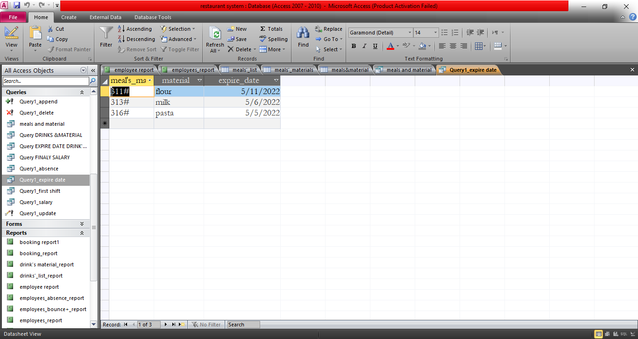
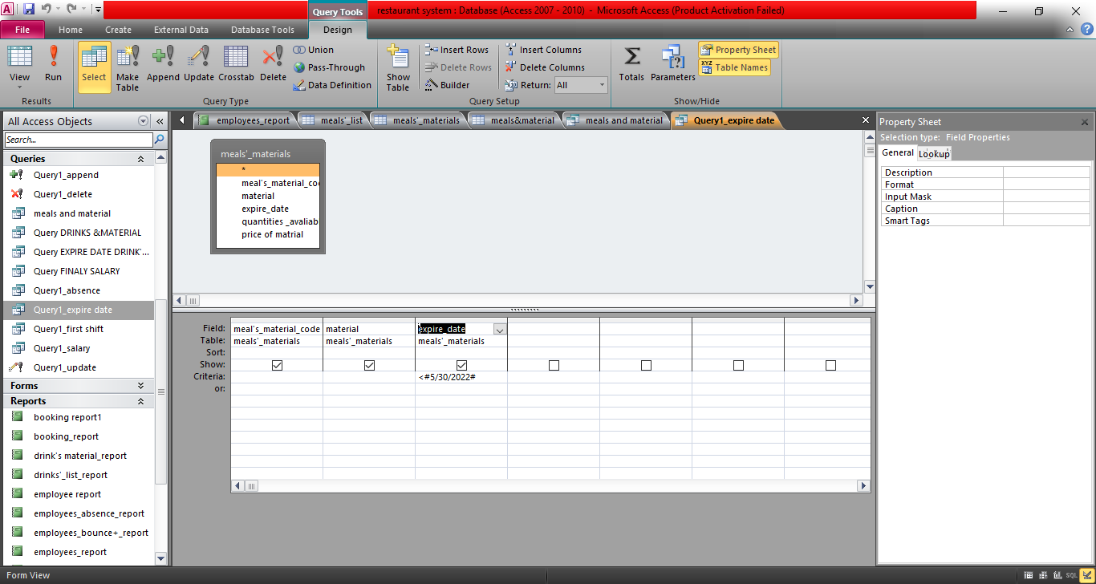
Query Meal and material
Inquire about raw materials whose expiry date is approaching, and to know the meals that contain these materials

Slide 13
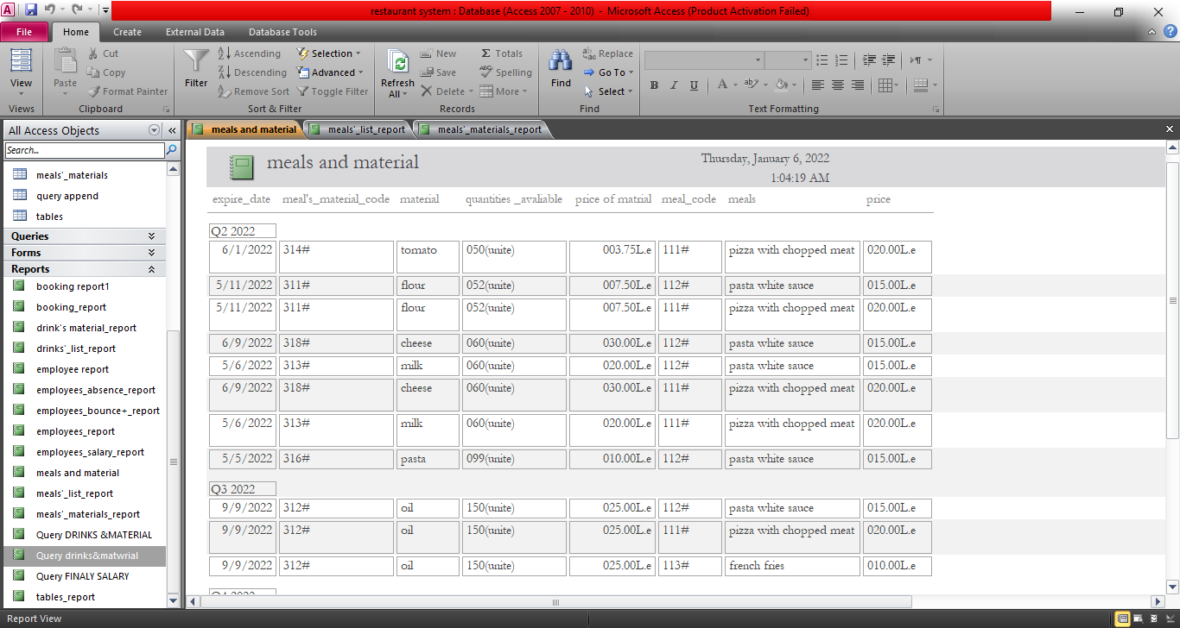
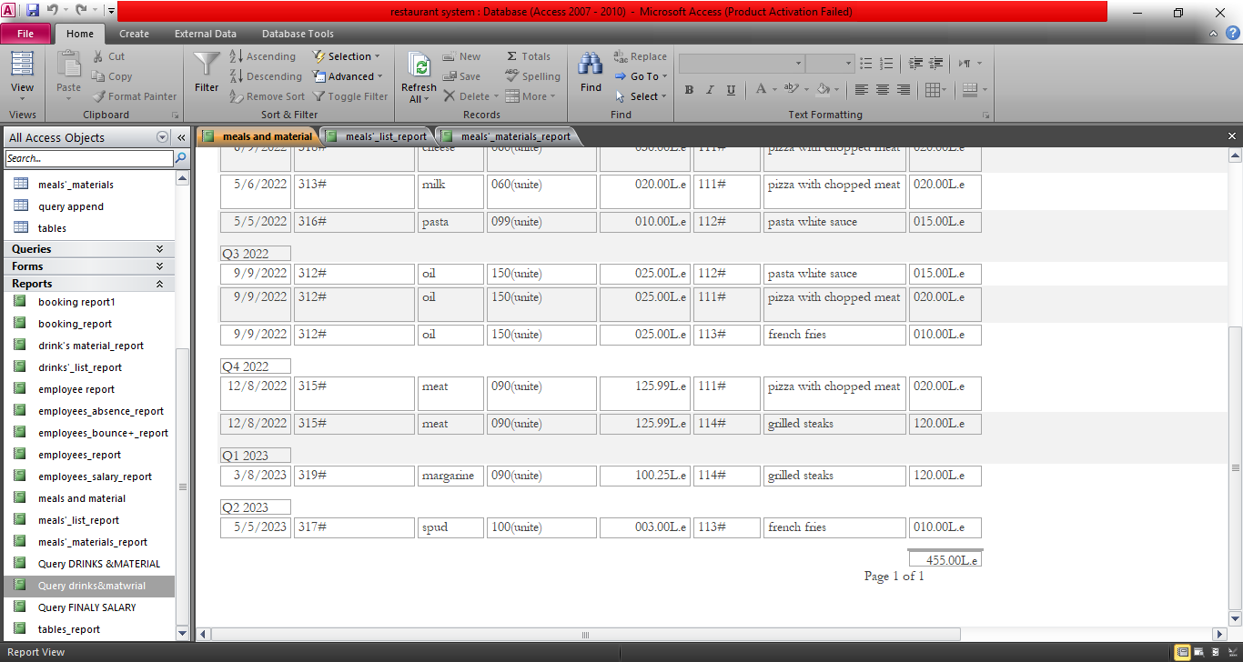
Report of meals and material
Report of meals & material

Slide 14
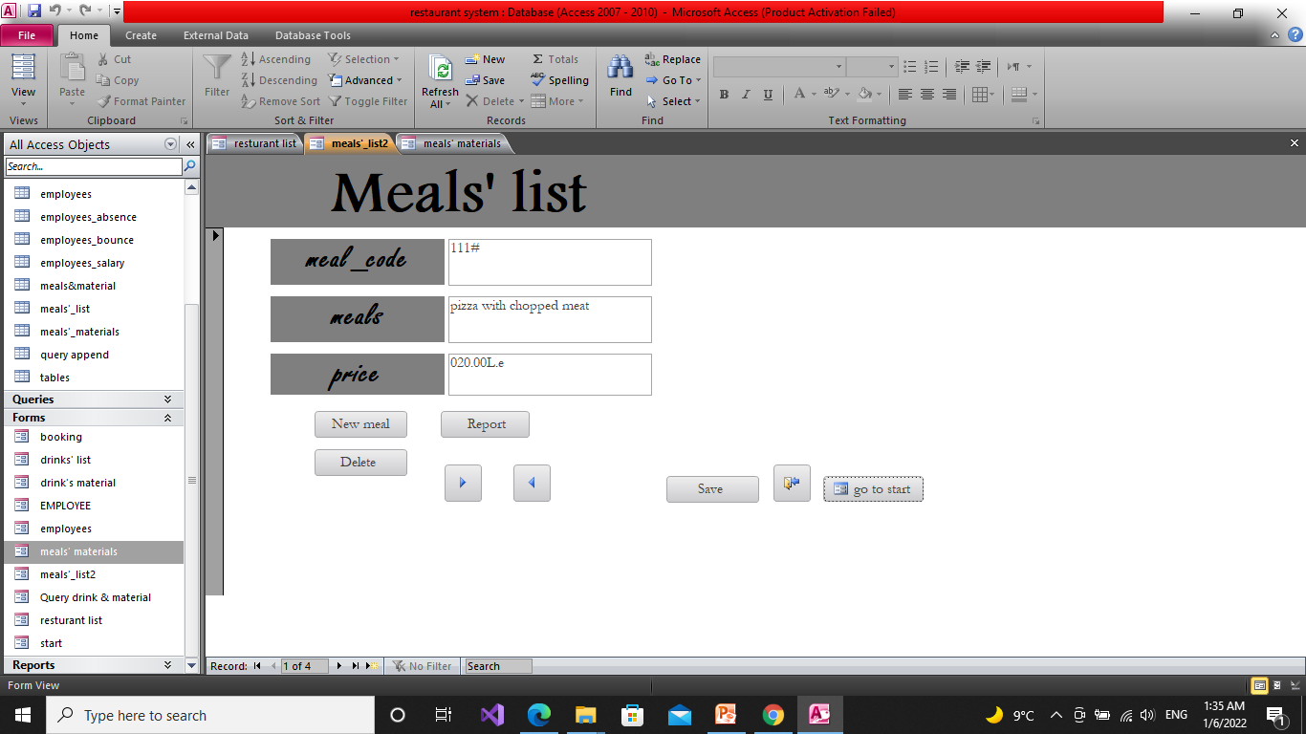
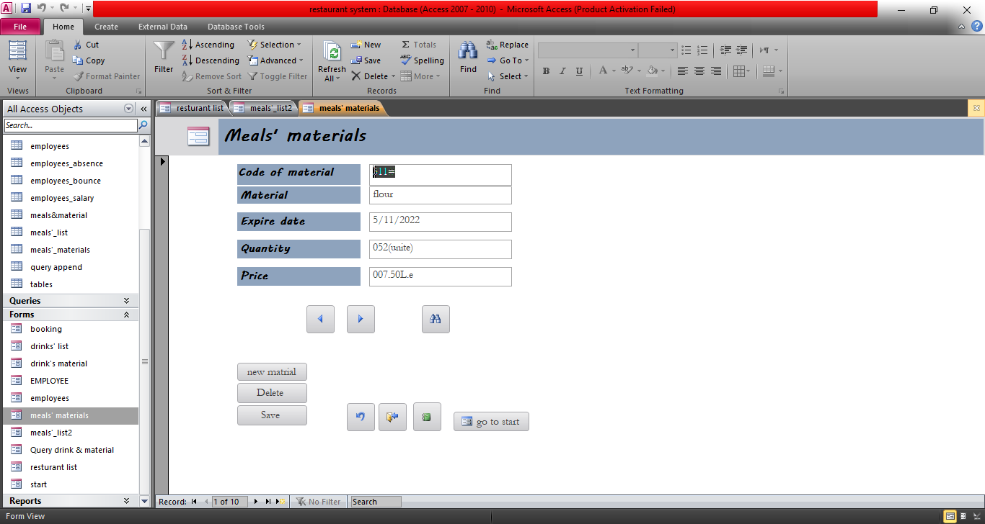
Meals and material forms
#Meal form: # Material form:

Slide 15
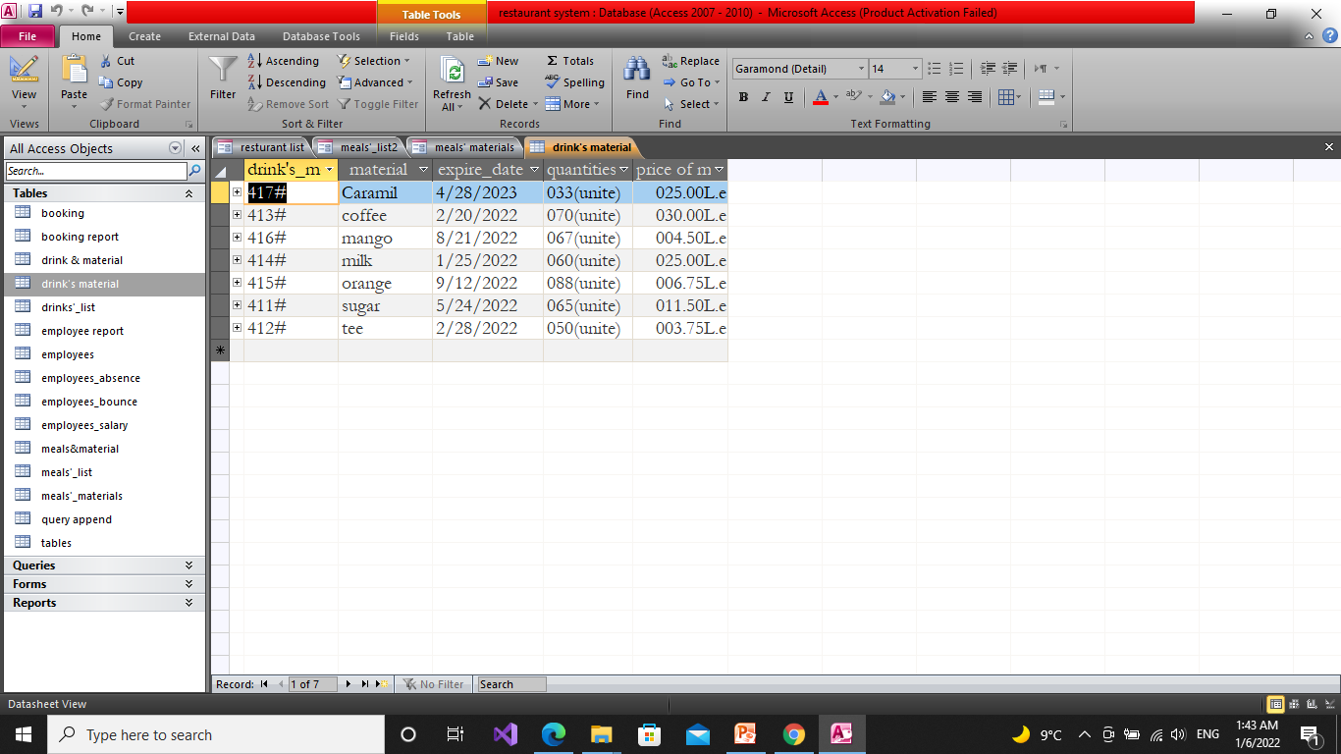
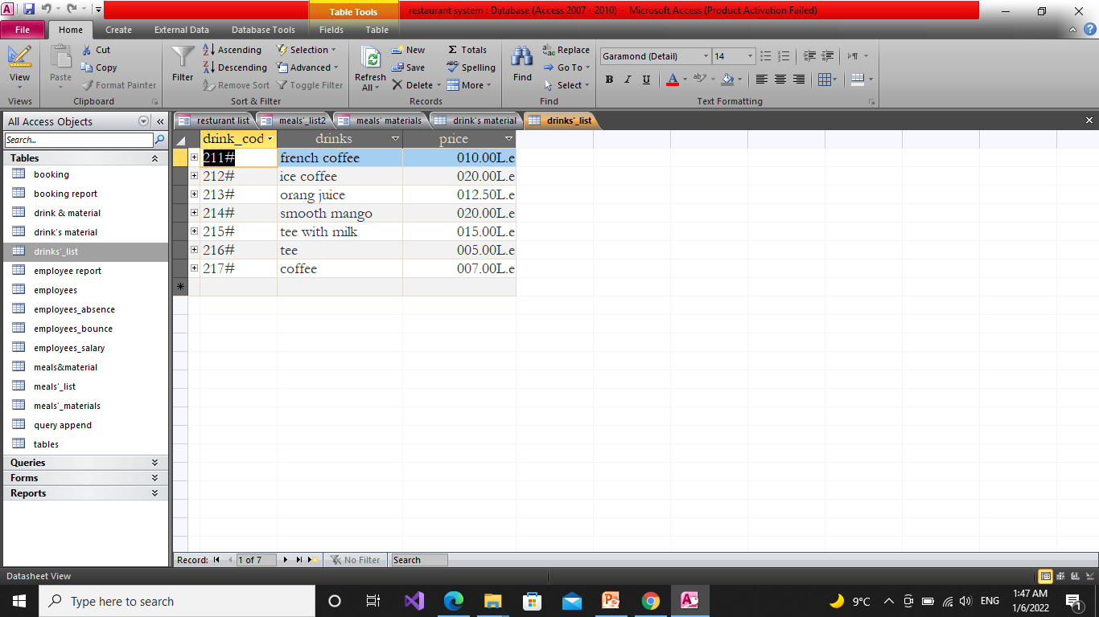
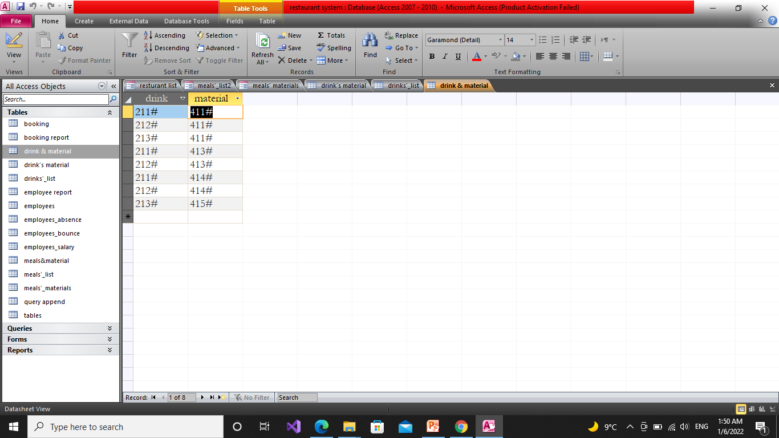
Drink & material
drink table contain of 3 columns [the code of drink ,drink ,and the price of drink] and the code drink is a primary key.
Material table contain of 5 columns [the code of material ,material ,expiry date of material ,quantity of material ,and the price of one unit of material]and the code of material is the primary key.
drink and material both are related with many-to-many relationship by using anther table “drink & material” which contain of the code of drink and the code of material.
#Drink material #Drink list #Drink & material

Slide 16
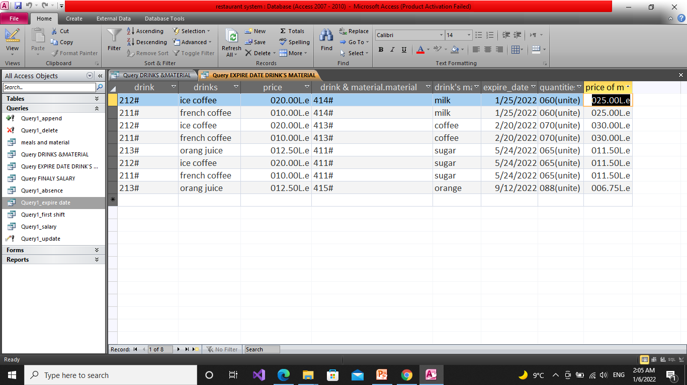
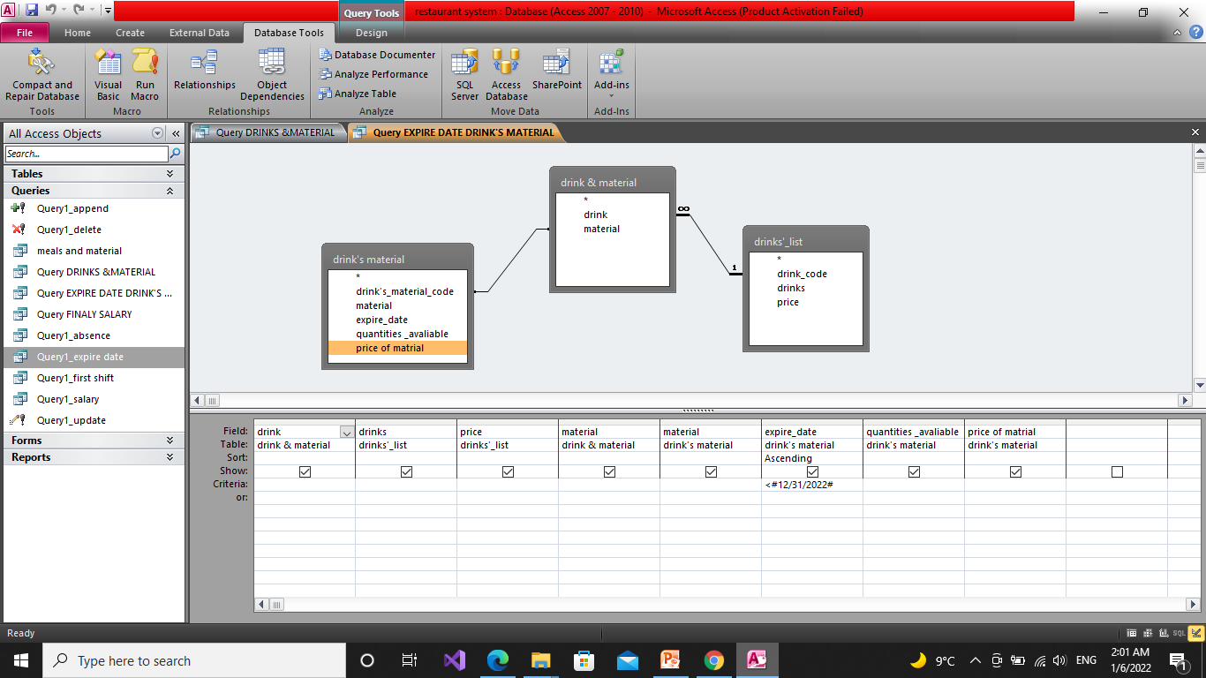
Query of drink & material
Inquire about raw materials whose expiry date is approaching, and to know the drinks that contain these materials

Slide 17
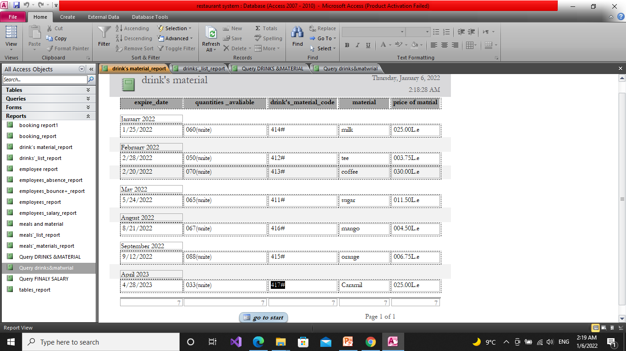
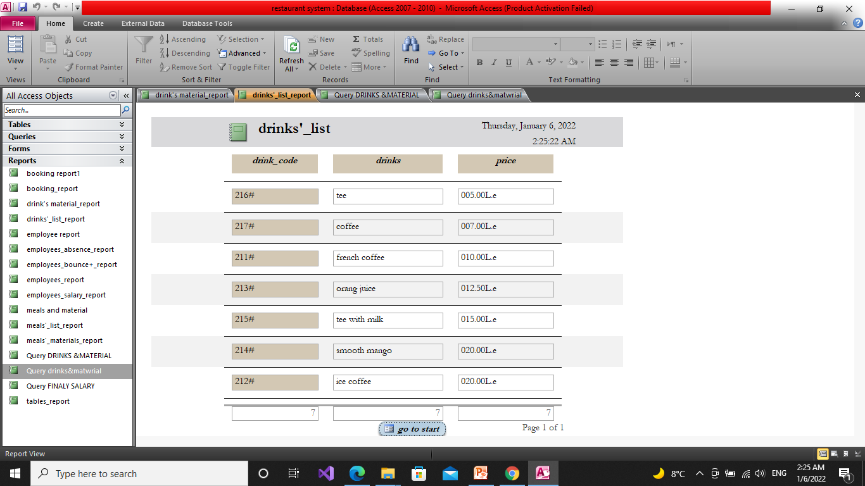
Report of drink & material
#Drink material #Drink list

Slide 18
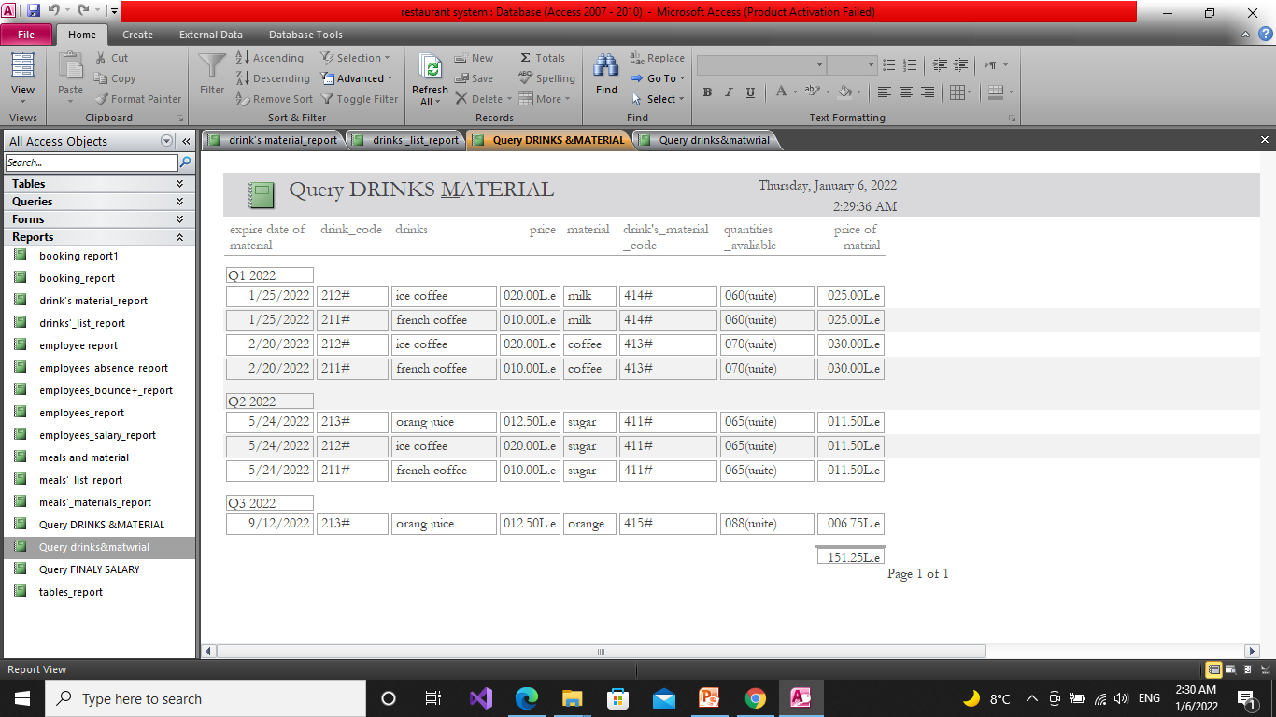
Report of drink & material
Drink & material

Slide 19
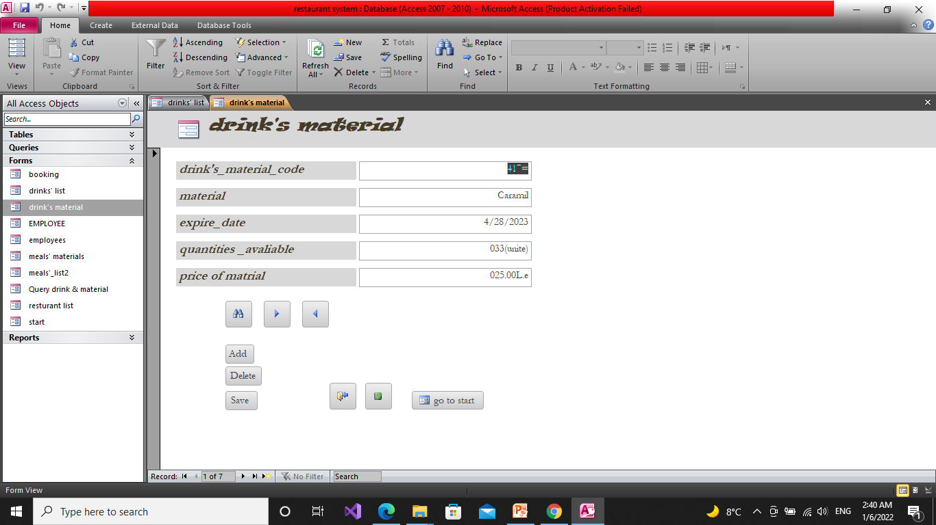
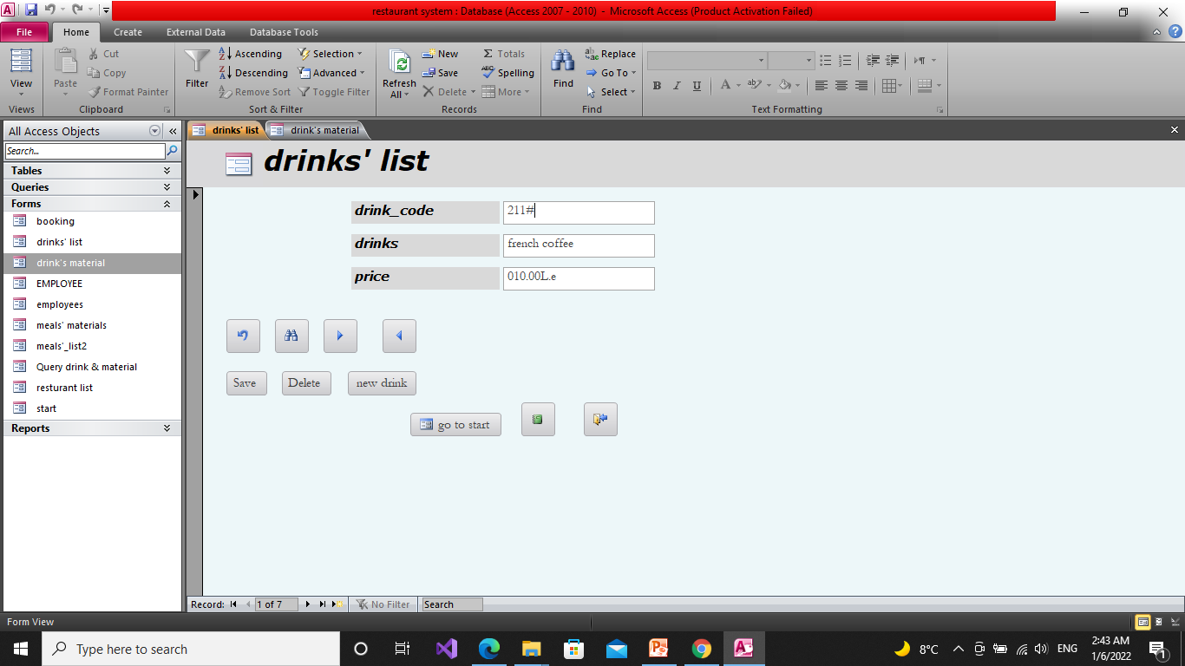
Form of drink & material
# Drink material #Drink list

Slide 20
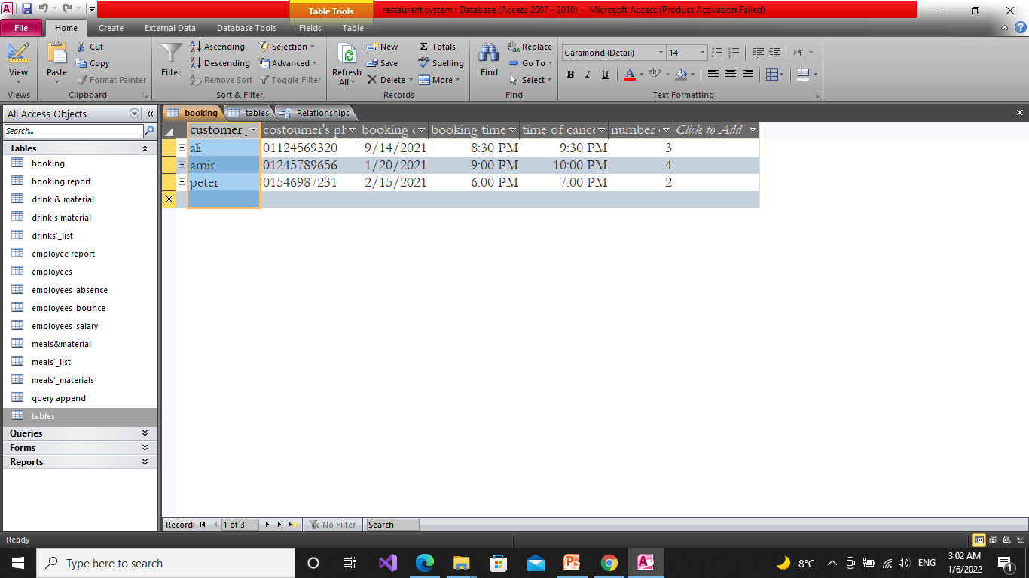
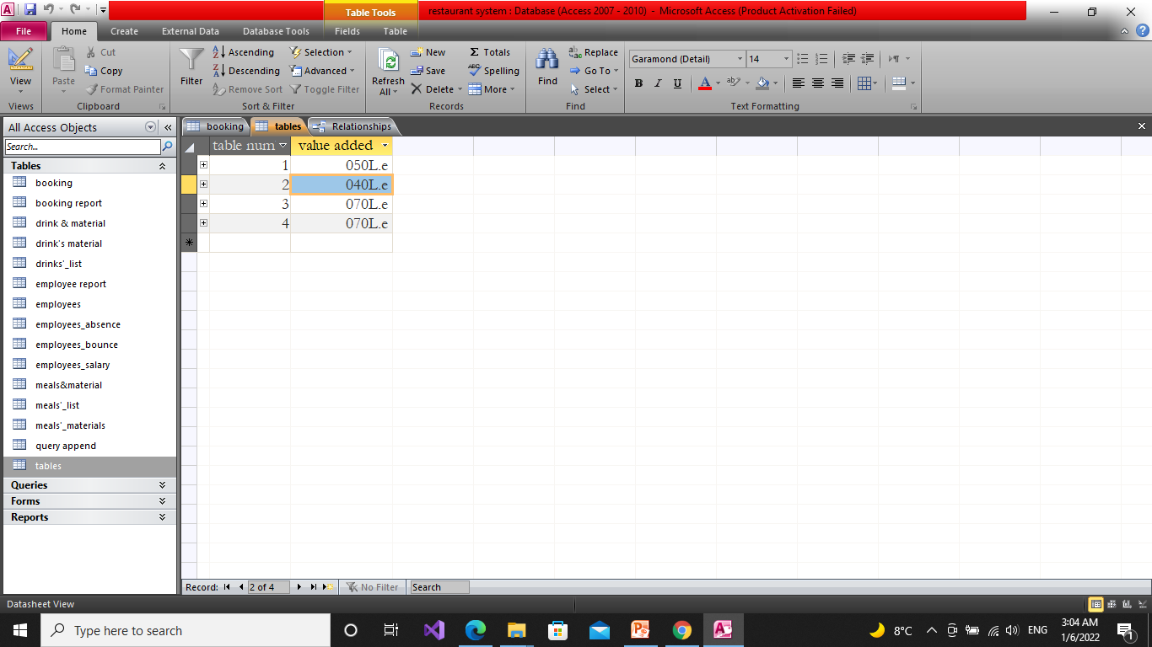
Booking & tables
Booking table contain customer data in 6 columns [customer name ,customer telephone number ,booking day, booking time , cancelled time , and number of table] as customer name is the primary key.
Tables table contain of 2 columns[ table number , Value Added] as number of tables is a primary key.
#Booking #tables

Slide 21
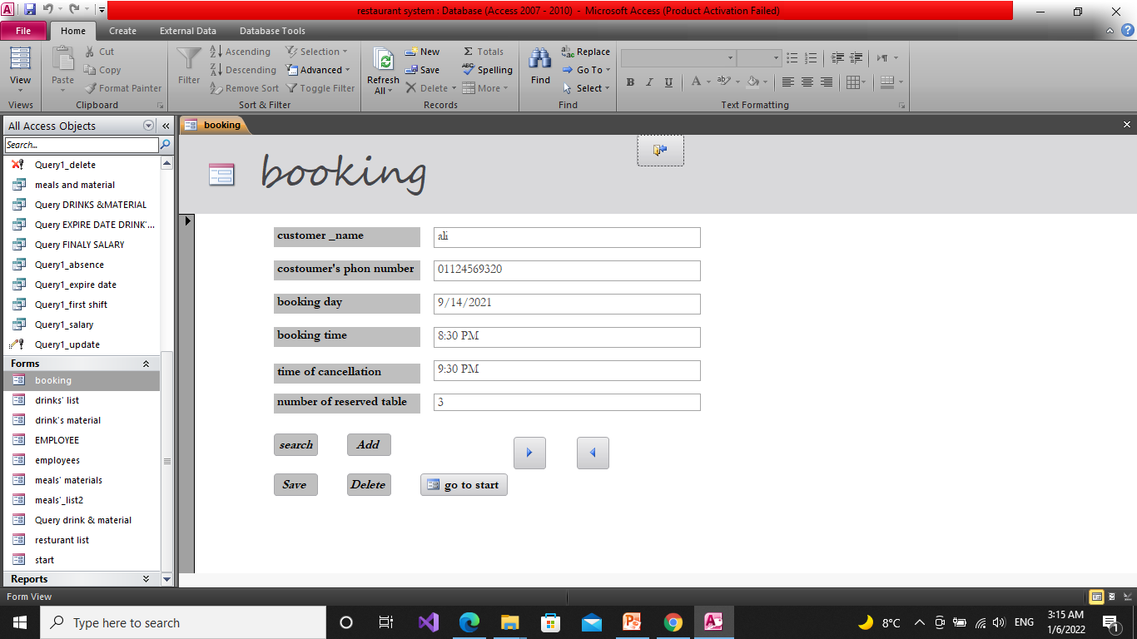
Form of booking
Booking form

Slide 22
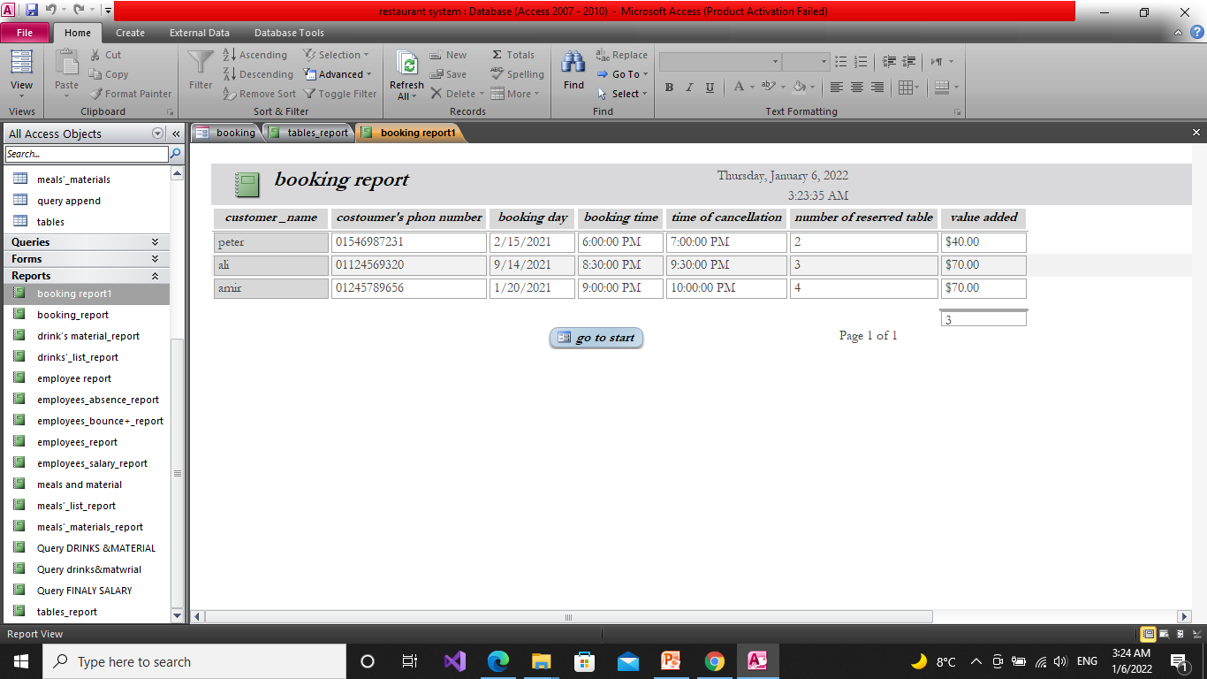
Report of booking & tables

Slide 23
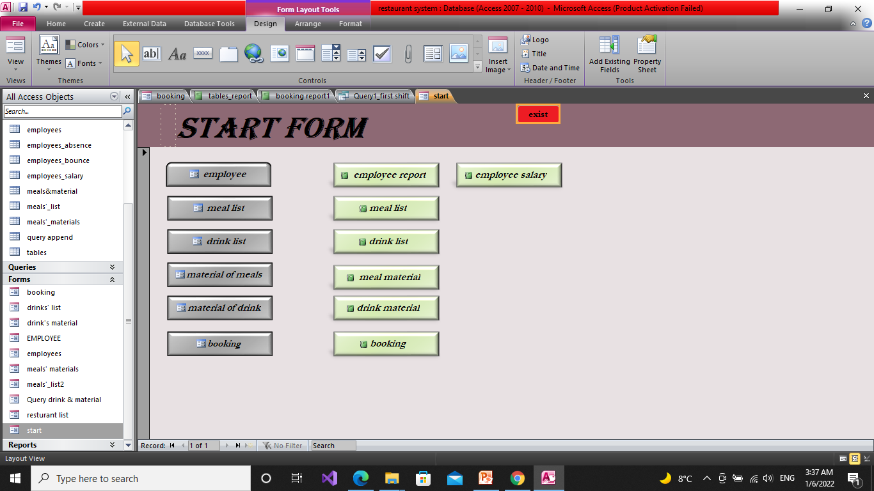
Start form

Slide 24
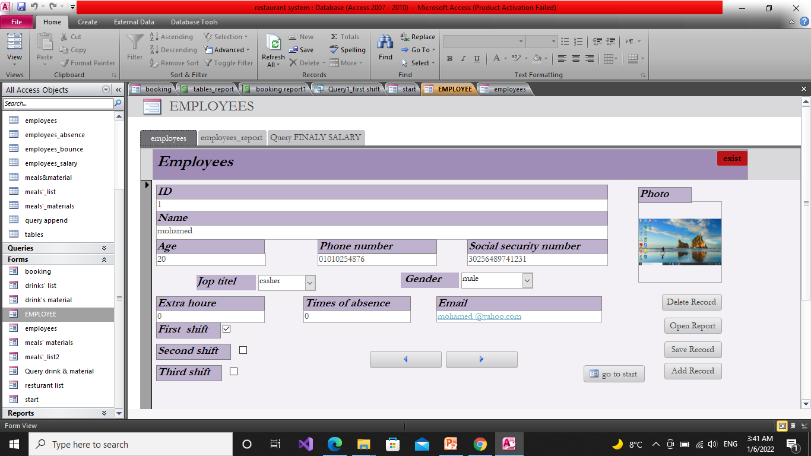
Navigation form of employee

Slide 25
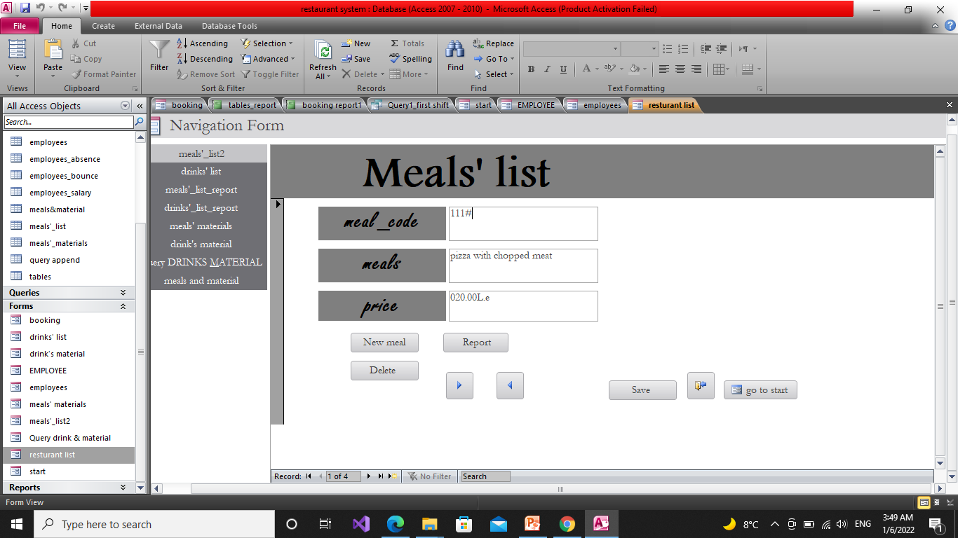
Navigation form for Restaurant list

Slide 26
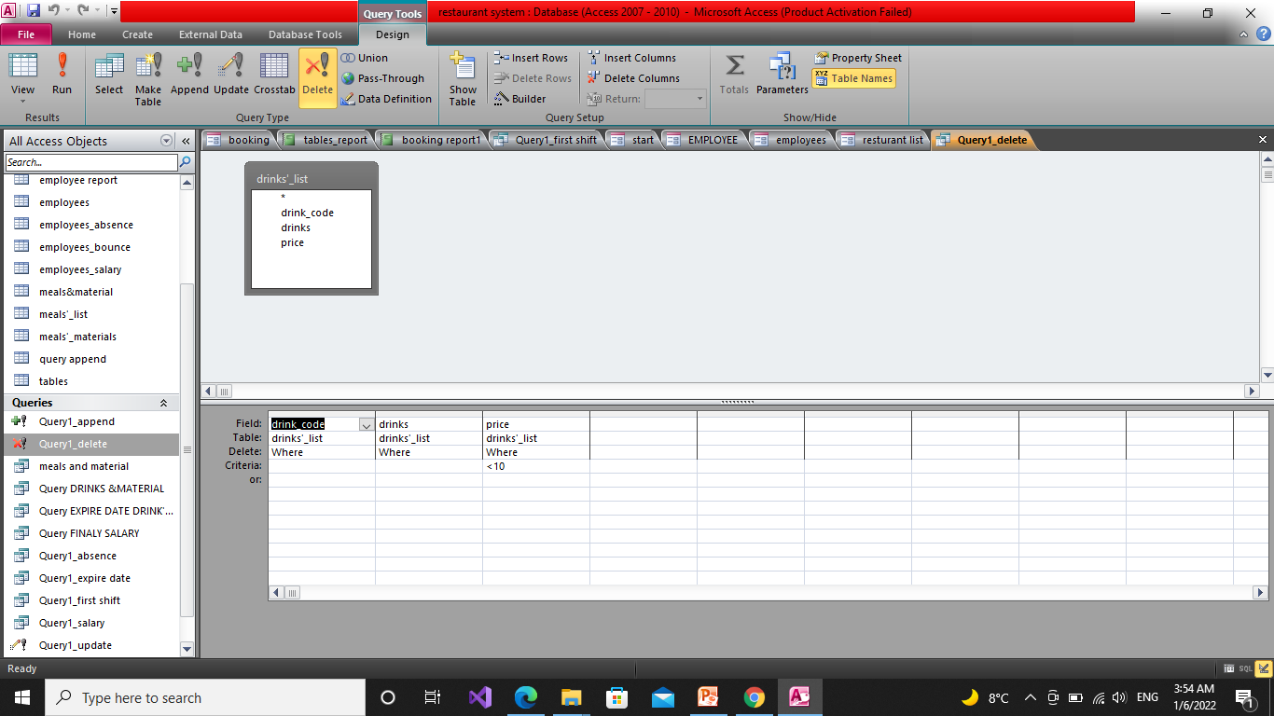
Query delete
We use it to delete any drink witch its price lese than 10le.

Slide 27
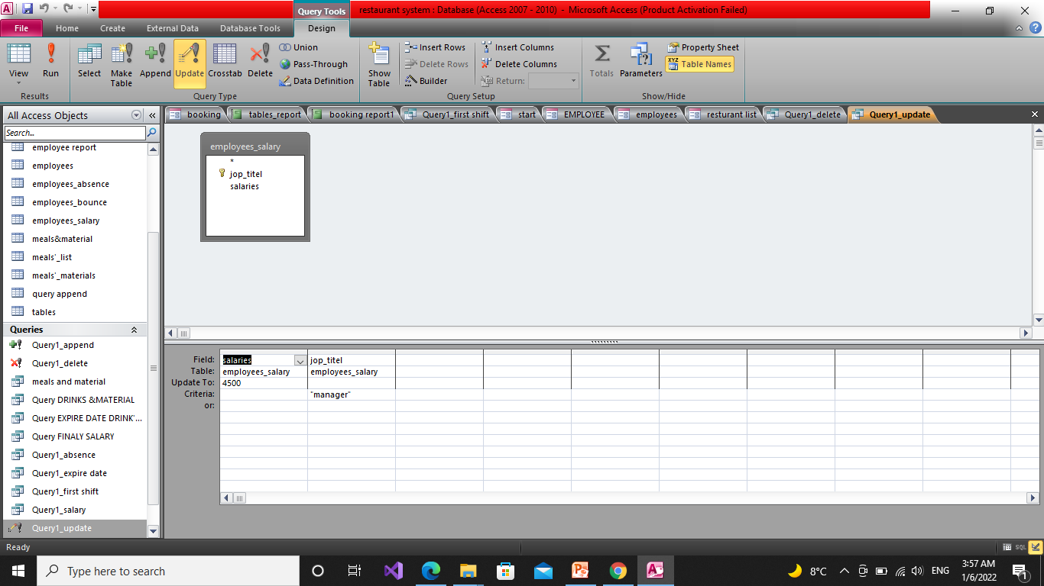
Query update
We use this query to update manger salary.

Slide 28
Project team
Member of team:
اردينا اسعد امين
اسراء احمد عبد الغفور
اروي سيد ابراهيم
اروى محمد حمدي
Project link:
https://github.com/IsraaAhmed22/Information_System_Project.git

